Slide 1
MAVEN TOY DATA ANALYSIS
(USING SQL)

Slide 2
PROBLEM STATEMENT
The aim of this SQL project is to analyze the toy sales data to gain insights into inventory management, product performance, sales trends, and store operations.
The analysis will be performed using four tables:
inventory,
products,
sales,
and stores.

Slide 3
ER (ENTITY RELATIONSHIP) DIAGRAM OF THE DATASET

Slide 4
Dataset Description :
1. inventory
• Store_ID: Unique identifier for the store.
• Product_ID: Unique identifier for the product.
• Stock_On_Hand: Number of units available in stock.
2. products
• Product_ID: Unique identifier for the product.
• Product_Name: Name of the product.
• Product_Category: Category of the product
(e.g., educational, plush, action figures, etc.).
• Product_Cost: Cost price of the product.
• Product_Price: Selling price of the product.
3. sales
• Sale_ID: Unique identifier for the sale.
• Date: Date the sale was made.
• Store_ID: Identifier linking to the stores table.
• Product_ID: Identifier linking to the products table.
• Units: Number of units sold.
4. stores
• Store_ID: Unique identifier for the store.
• Store_Name: Name of the store.
• Store_City: City where the store is located.
• Store_Location: Location details of the store.
• Store_Open_Date: Date when the store was opened.

Slide 5
In order to evaluate overall performance, we focused on the following key metrics:
Total units sold
Total revenue / Total sales
Monthly sales
Sales by category
Sales (%)
Current inventory levels
Profit
Profit margin (%)
Average product cost
Growth percentage
Store’s age in years

Slide 6
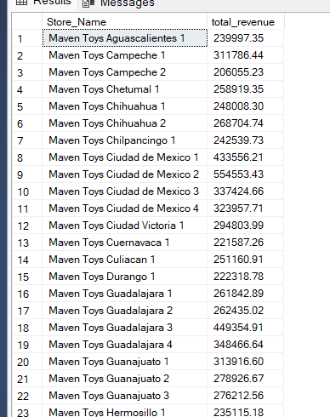
--1. What is the total sales revenue generated by each store?
SELECT st.Store_Name, SUM(p.Product_Price * sa.Units) AS total_revenue
FROM sales sa
JOIN stores st
ON sa.Store_ID = st.Store_ID
JOIN products p
ON sa.Product_ID = p.Product_ID
GROUP BY st.Store_Name;

Slide 7
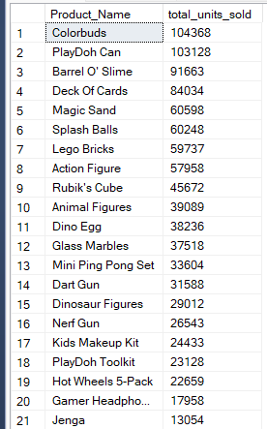
--2. Which products are the top-selling in terms of units sold?
SELECT p.Product_Name, SUM(sa.Units) AS total_units_sold
FROM sales sa
JOIN products p
ON sa.Product_ID = p.Product_ID
GROUP BY p.Product_Name
ORDER BY total_units_sold DESC;

Slide 8
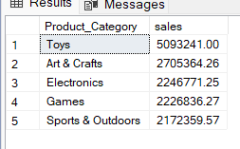
--3. What is the sales performance by product category?
SELECT p.Product_Category, SUM(p.Product_Price*sa.Units) AS sales
FROM sales sa
JOIN products p
ON sa.Product_ID = p.Product_ID
GROUP BY p.Product_Category
ORDER BY sales DESC;

Slide 9
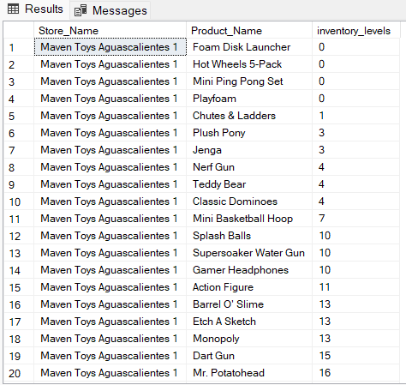
--4. What are the current inventory levels for each product at each store?
SELECT st.Store_Name, p.Product_Name, i.Stock_On_Hand AS inventory_levels
FROM inventory i
JOIN stores st
ON i.Store_ID = st.Store_ID
JOIN products p
ON i.Product_ID = p.Product_ID
ORDER BY st.Store_Name, i.Stock_On_Hand;

Slide 10
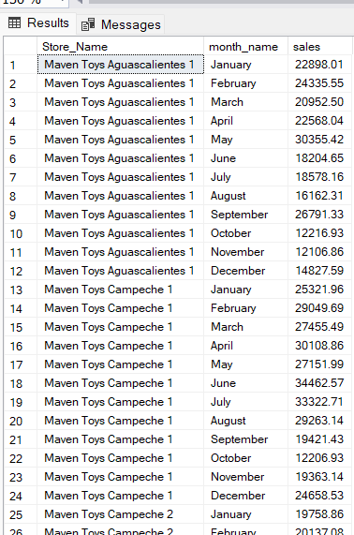
--5.How do monthly sales trends vary across different stores?
SELECT
st.Store_Name,
DATENAME(month, sa.Date) AS month_name,
SUM(p.Product_Price * sa.Units) AS sales
FROM sales sa
JOIN stores st ON sa.Store_ID = st.Store_ID
JOIN products p ON sa.Product_ID = p.Product_ID
GROUP BY st.Store_Name, DATENAME(month, sa.Date), MONTH(sa.Date)
ORDER BY st.Store_Name, MONTH(sa.Date);

Slide 11
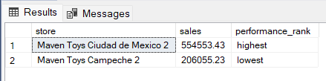
--6.Which stores have the highest and lowest sales performance?
WITH sales_cte AS
(
SELECT st.Store_Name AS store, SUM(p.Product_Price * sa.Units) AS sales
FROM sales sa
JOIN products p ON sa.Product_ID = p.Product_ID
JOIN stores st ON sa.Store_ID = st.Store_ID
GROUP BY st.Store_Name
),
sales_summary AS
(
SELECT MAX(sales) AS max_sales, MIN(sales) AS min_sales
FROM sales_cte
)
SELECT store, sales,
CASE
WHEN sales = s.max_sales THEN 'highest'
WHEN sales = s.min_sales THEN 'lowest'
END AS performance_rank
FROM sales_cte
CROSS JOIN sales_summary s
WHERE sales = s.max_sales OR sales = s.min_sales
ORDER BY sales DESC;

Slide 12
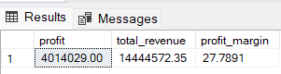
--7. What is the profit margin for each product?
SELECT SUM(p.Product_Price * sa.Units) - SUM(p.Product_Cost * sa.Units) AS profit,
SUM(p.Product_Price * sa.Units) AS total_revenue,
(SUM(p.Product_Price * sa.Units) - SUM(p.Product_Cost * sa.Units))*100/SUM(p.Product_Price * sa.Units) AS profit_margin
FROM products p
JOIN sales sa
ON p.Product_ID = sa.Product_ID

Slide 13
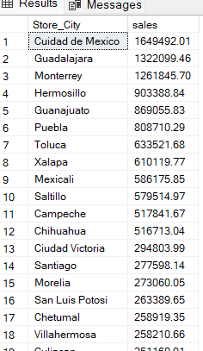
--8.How are sales distributed across different cities?
SELECT st.Store_City, SUM(p.Product_Price*sa.Units) AS sales
FROM sales sa
JOIN stores st
ON sa.Store_ID = st.Store_ID
JOIN products p
ON sa.Product_ID = p.Product_ID
GROUP BY st.Store_City
ORDER BY sales DESC;

Slide 14
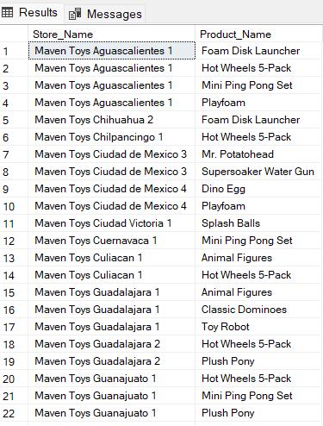
--9.Which products are out of stock in each store?
SELECT st.Store_Name, p.Product_Name
FROM inventory i
JOIN stores st
ON i.Store_ID = st.Store_ID
JOIN products p
ON i.Product_ID = p.Product_ID
WHERE i.Stock_On_Hand = 0
ORDER BY st.Store_Name,p.Product_Name;

Slide 15
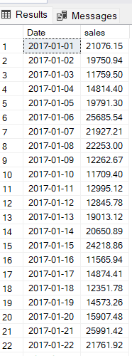
--10.How do sales vary by specific dates?
SELECT sa.Date, SUM(p.Product_Price*sa.Units) AS sales
FROM sales sa
JOIN products p
ON sa.Product_ID = p.Product_ID
GROUP BY sa.Date
ORDER BY sa.Date;

Slide 16
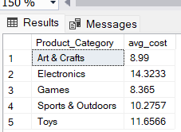
--11.What is the average cost of products in each category?
SELECT Product_Category, AVG(Product_Cost) AS avg_cost
FROM products
GROUP BY Product_Category;

Slide 17
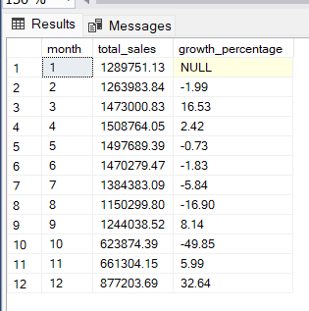
--12.What is the sales growth over time for the entire company?
SELECT
MONTH(Date) AS month,
SUM(p.Product_Price * sa.Units) AS total_sales,
(SUM(p.Product_Price * sa.Units) -
LAG(SUM(p.Product_Price * sa.Units)) OVER (ORDER BY MONTH(Date)))
/ LAG(SUM(p.Product_Price * sa.Units)) OVER (ORDER BY MONTH(Date)) * 100 AS growth_percentage
FROM sales sa
JOIN products p
ON sa.Product_ID = p.Product_ID
GROUP BY MONTH(sa.Date)
ORDER BY month;

Slide 18
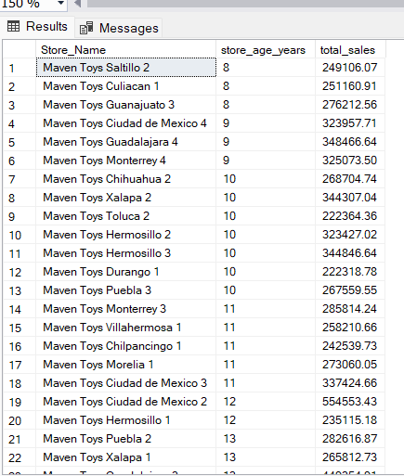
--13.How does the store open date affect sales performance?
SELECT st.Store_Name,
DATEDIFF(YEAR, st.Store_Open_Date, GETDATE()) AS store_age_years,
SUM(p.Product_Price * sa.Units) AS total_sales
FROM sales sa
JOIN products p
ON sa.Product_ID = p.Product_ID
JOIN stores st
ON sa.Store_ID = st.Store_ID
GROUP BY st.Store_Name, st.Store_Open_Date
ORDER BY store_age_years;

Slide 19
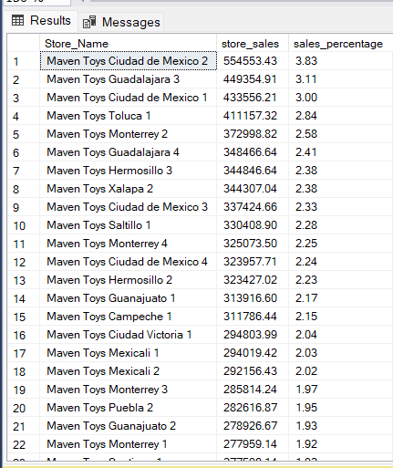
--14.What percentage of total sales does each store contribute?
SELECT st.Store_Name,
SUM(p.Product_Price * sa.Units) AS store_sales,
(SUM(p.Product_Price * sa.Units) / (SELECT SUM(p.Product_Price * sa.Units
FROM sales sa
JOIN products p
ON sa.Product_ID = p.Product_ID)) * 100
AS sales_percentage
FROM sales sa
JOIN products p ON sa.Product_ID = p.Product_ID
JOIN stores st ON sa.Store_ID = st.Store_ID
GROUP BY st.Store_Name
ORDER BY sales_percentage DESC;

Slide 20
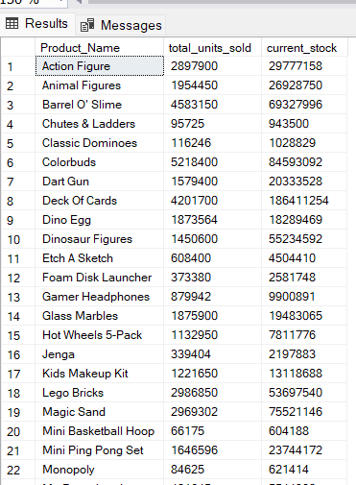
--15.How do sales compare to current stock levels for each product?
SELECT p.Product_Name,
SUM(sa.Units) AS total_units_sold,
SUM(i.Stock_On_Hand) AS current_stock
FROM sales sa
JOIN products p
ON sa.Product_ID = p.Product_ID
JOIN inventory i
ON p.Product_ID = i.Product_ID
GROUP BY p.Product_Name
ORDER BY p.Product_Name;

Slide 21
Thank you !

